Slide 1
Sentiment Analysis in User Reviews
Group 14 • Hari Sai Raghuram V • Raman Dutt

Slide 2
Abstract
What is Sentiment Analysis?
Sentiment Analysis refers to the use of Natural Language Processing, Text Analysis to identify, extract, quantify and study affective states.
Sentiment analysis comes under data mining and is highly important for companies these days.

Slide 3
Importance of Sentiment Analysis
Adjust Marketing Strategy - By listening to what your customers feel and think about your brand, you can adjust your high-level messaging to meet their needs.
Develop Product Quality - Your customers can essentially become micro-influencers for you. That is why it is of utmost importance to have the best customer service in place and keep your current customers happy.
Improve Customer Service - Once your customer purchases your product, you want to keep them loyal to your brand as long as possible, and be an evangelist for your brand.
.

Slide 4


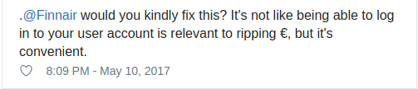
Importance of Sentiment Analysis

Slide 5
Data Overview

Slide 6
Dataset
The data set was obtained from Multi Domain Sentiment Dataset from Department of Computer Science John Hopkins University.
This dataset contains review taken from Amazon.com for 4 product domains:
DVD’s, Books, Electronics, Kitchen

Slide 7
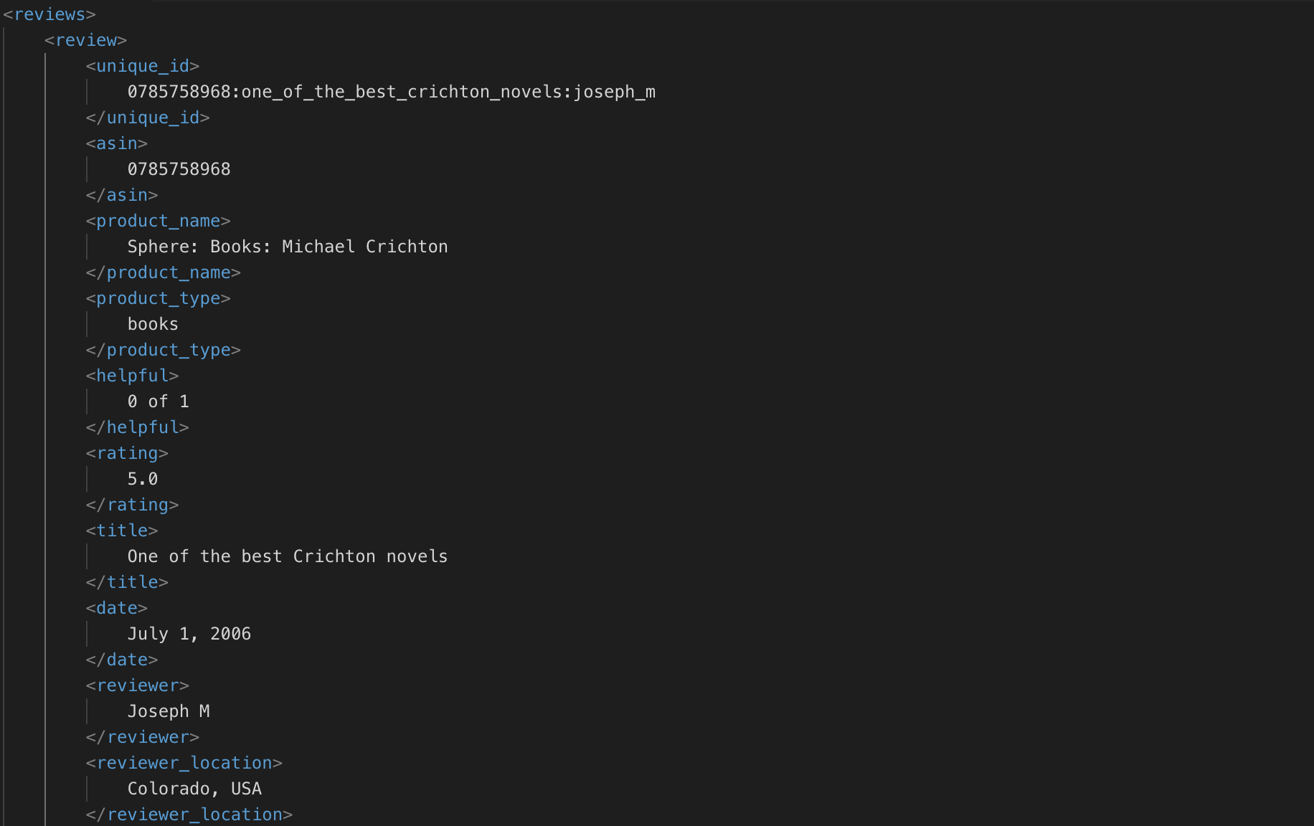
Pseudo XML file
Some manual effort was required for making the file readable (Making file into a proper XML file):
Replaced all & with &amp;
Replaced all “ with &quot;
Replaced all ‘ with &apos;
And so on …
Now the data is readable by Python program.

Slide 8
Data Preprocessing

Slide 9
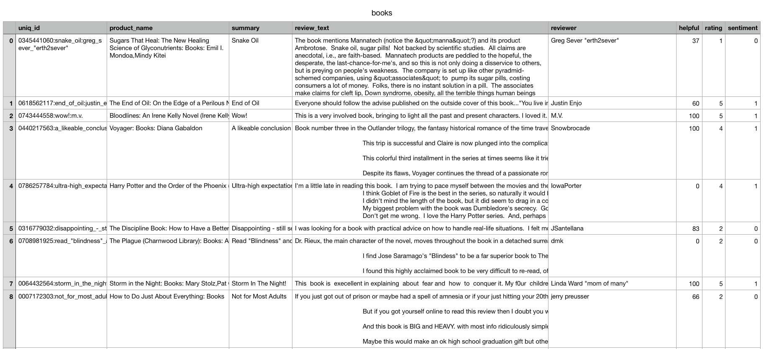
Reading XML files
The python file reads the XML file using the library xml.etree.
It finds the root tag of the XML file and helps us find all the required fields.
The positive and negative data has been mixed randomly.
We have only extracted required fields from the XML file and stored it in CSV files for future uses.

Slide 10
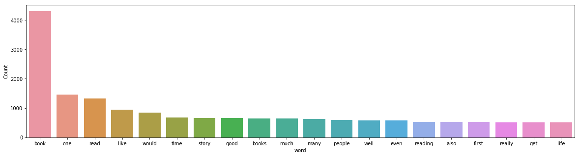
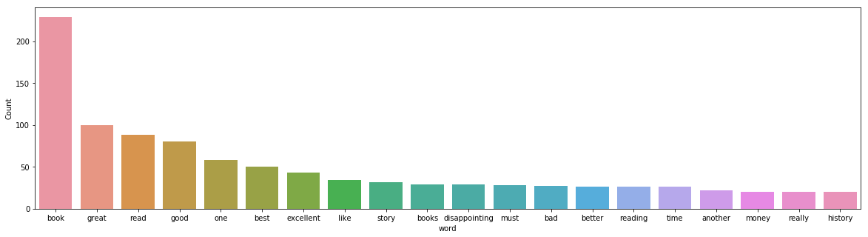
Cleaning the data
The extracted data was then checked for frequent words.
The stop words were removed.
The text was converted to lower case to maintain uniformity.
Some of the unwanted symbols were removed.
Reviews
Summary

Slide 11
Training Models

Slide 12
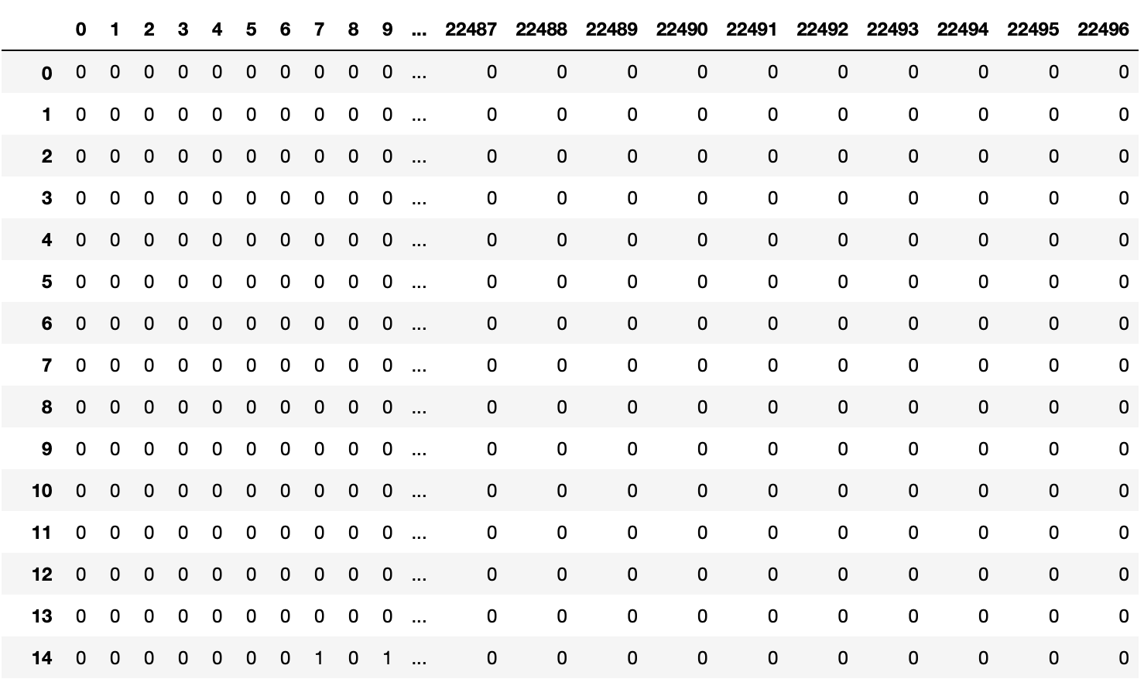
Model Training
The entire workflow was created in form of pipeline
Pipeline:
Countvectorizer
Tf-idf Transformer
Model
Count Vector Matrix

Slide 13
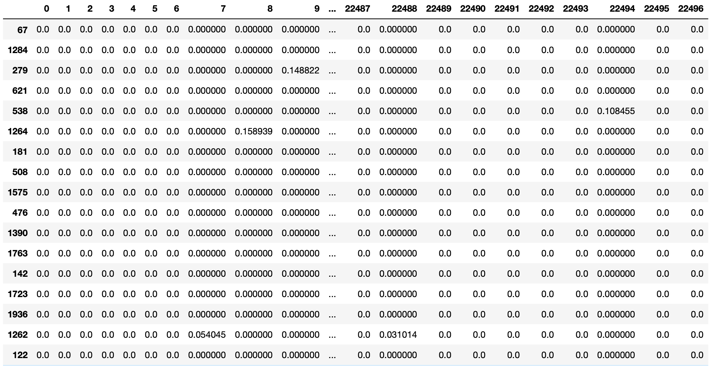
Tf-idf Matrix

Slide 14
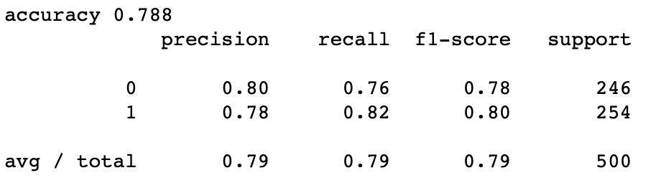
Evaluating trained models
To evaluate our trained models we have split our training data into train and test data at 3:1 ratio.
We have predicted the output on test data using the trained model.
We have generated Classification report for each model trained.
Classification Report

Slide 15
Training Models
We have trained our models twice each using the two required prediction outputs:
Sentiment
Ratings ( 0 - 5)
We have initially used reviews as our predictors
We tried using Summary as the predictor, which gave our bad results.
We have even tried using both reviews and summary as our predictors.
Finally, we concluded that using only Reviews gives us better performance

Slide 16
Results

Slide 17
Accuracy - Sentiment Prediction
Algorithm Used | Accuracy
Naive Bayes | 0.826
Support Vector Machine | 0.839
Logistic Regression | 0.8245
Random Forest Classifier | 0.826
We observe that Support Vector Machine gives us better results

Slide 18
Accuracy - Rating Prediction
Algorithm Used | Accuracy
Naive Bayes | 0.5435
Support Vector Machine | 0.6005
Random Forest Classifier | 0.588
Logistic Regression | 0.589
Decision Trees | 0.4245
AdaBoost | 0.5005
KNN | 0.4135
We observe that Support Vector Machine gives us better results

Slide 19
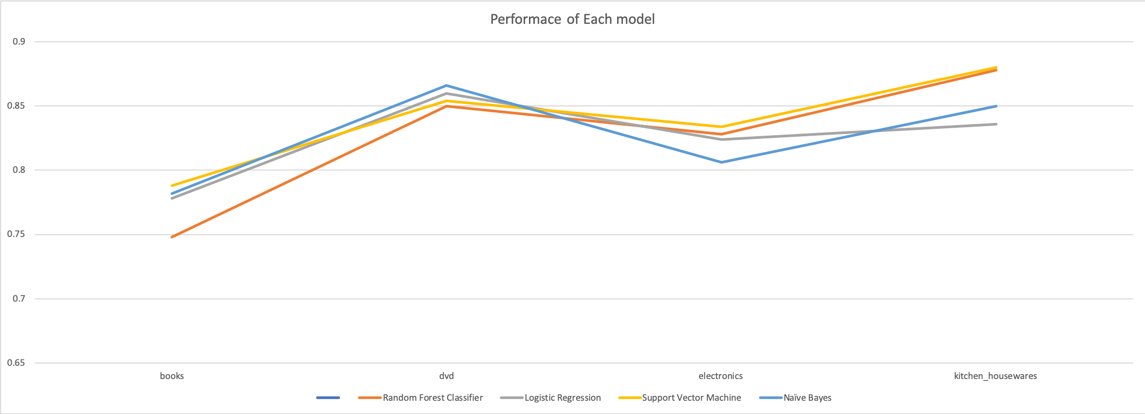
Sentiment Prediction

Slide 20
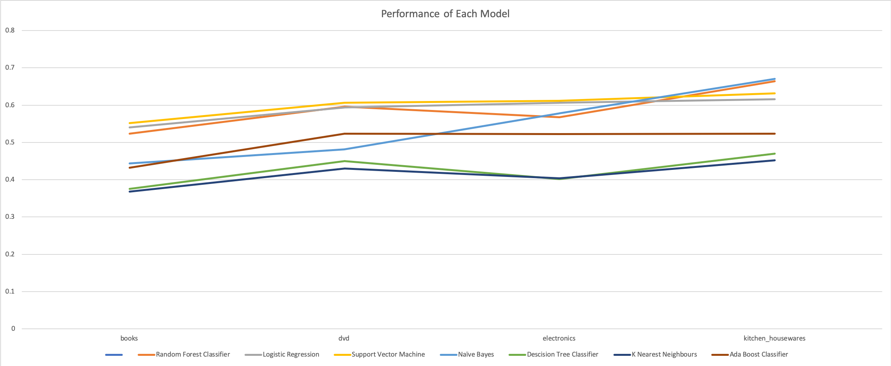
Rating Prediction

Slide 21
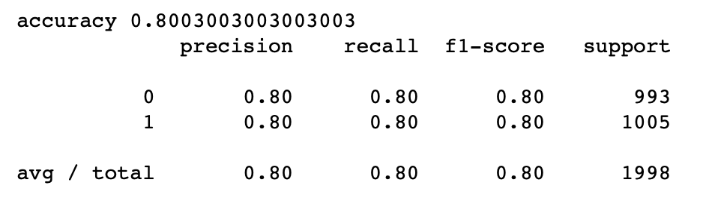
Sentiment Prediction - Report
Model : Support Vector Machine
Accuracy : 80.03%
Recall : 80%
Precision : 80%
F-1 Score : 80%

Slide 22
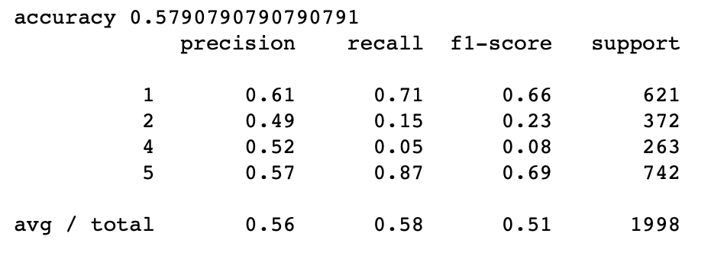
Ratings Prediction - Report
Model : Support Vector Machine
Accuracy : 57.90%
Recall : 58%
Precision : 56%
F-1 Score : 51%

Slide 23
Conclusion

Slide 24
In this project, we have attempted to predict sentiment of the users from the user reviews.
A pipeline of events was created for seamless and systematic work. These events included CountVectorizer, tf-idf transformer before finally feeding the data into the machine learning models. The data was divided into training and test sets for proper training and validation of the models.
From the results, we can clearly see that the Support Vector Machine gave the best results for both the tasks of Sentiment Prediction and Ratings Prediction.
For Sentiment Prediction, the second-best performance was given by Naive Bayes Classifier and Random Forests (both with an accuracy of 82.6%.)

Slide 25
Thank you
Group 14

